Slide 1
Introduction to Blockchain Technology

Slide 2
Contents:
Why we need Blockchain Technology?
What is Blockchain ?
Key Features of Blockchain
Blockchain Applications

Slide 3
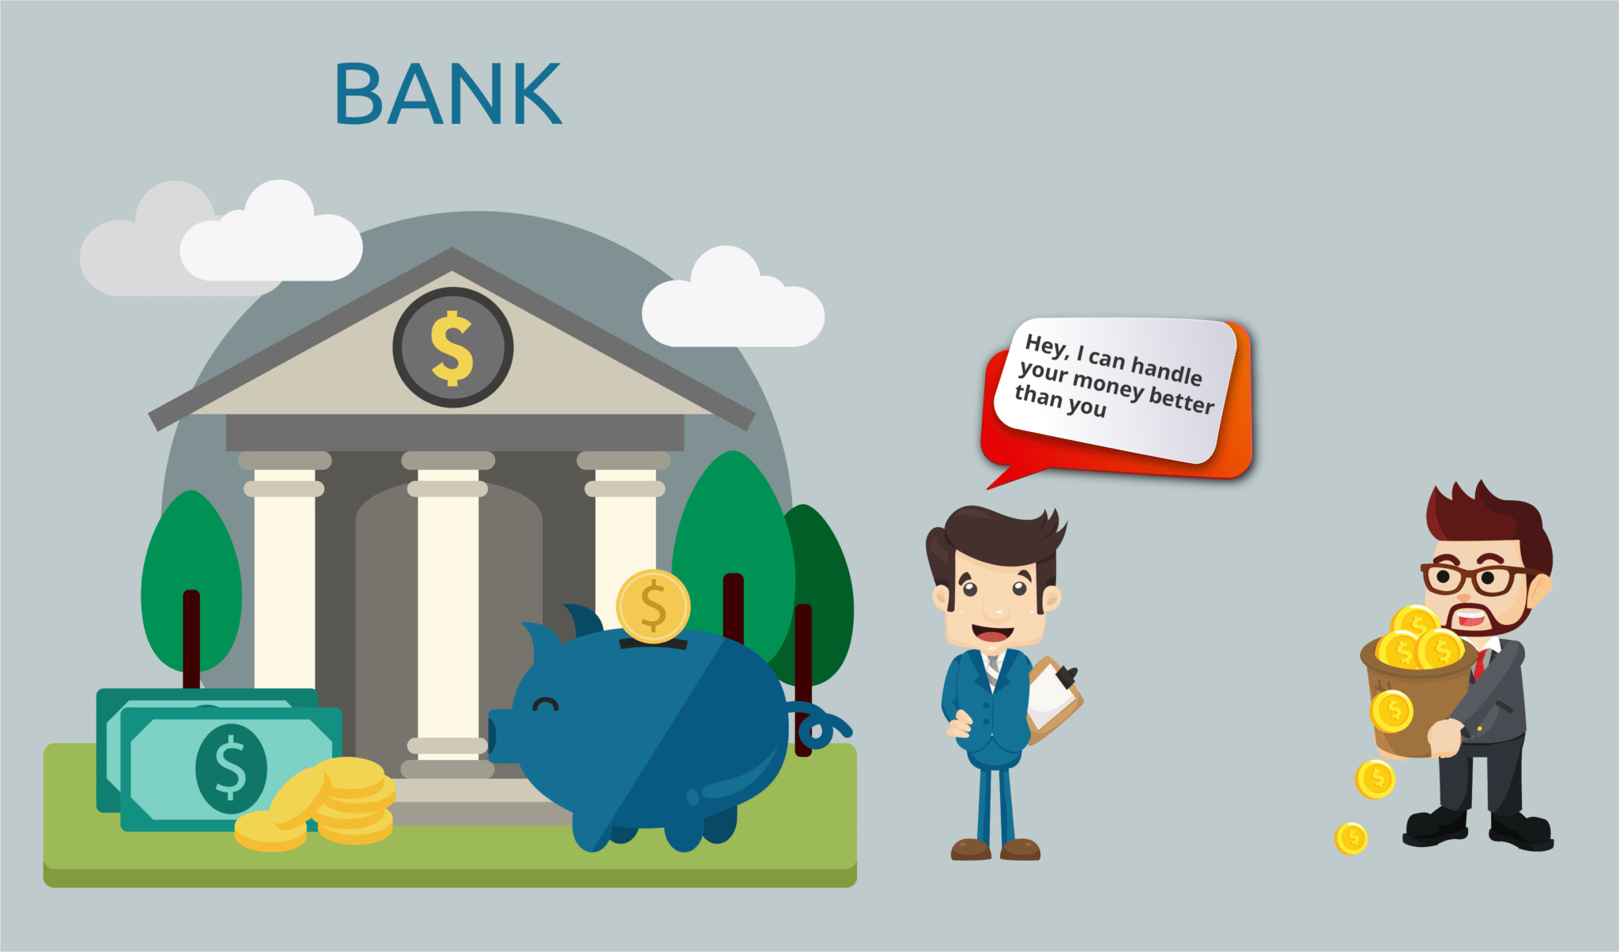
Why Blockchain: eg: Banking

Slide 4
These centralized third parties have an absurd amount of power in their hands, for eg:
They have all your information
They have the power to freeze your accounts
You have to trust the system
Economy crash : 2008 scenario

Slide 5
What is Blockchain ?

Slide 6
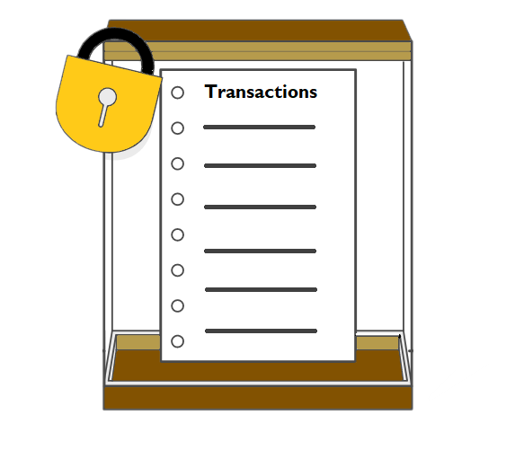
A block is the ‘current’ part of a Blockchain which records some or all of the recent transactions, and once completed goes into the Blockchain as permanent database

Slide 7
Key Features of Blockchain
Decentralization
Immutability
distributed-database

Slide 8
Blockchain Applications

Slide 9
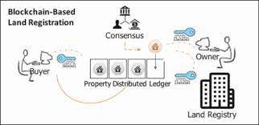
Land Registry

Slide 10
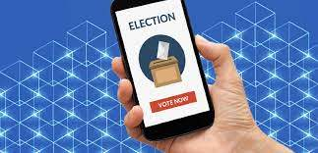
Voting

Slide 11
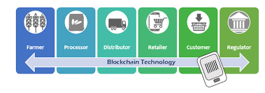
Food Industry

Slide 12
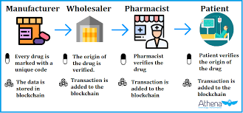
Drug Traceability

Slide 13
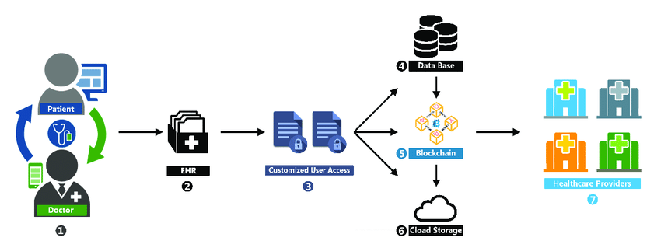
Patient Data Management

Slide 14
Queries ??

